Slide 1

K.S. SCHOOL OF ENGINEERING AND MANAGEMENT
DEPARTMENT OF ELECTRONICS AND COMMUNICATION ENGINEERING
Mini Project Presentation
on
Smart Car Parking System
Project Team
Niranjan P(1KG22EC084)
Suhas V (1KG22EC116)
Somanna H(1KG22EC113)
Rakesh K (1KG22EC096)
Under the Guidance of
Muskaan Huda
Notes:
1

Slide 2
Introduction
Urbanization has led to increased vehicle ownership, resulting in significant challenges related to parking space management. Traditional parking systems often suffer from inefficiencies, such as long search times for vacant spots, underutilization of available spaces, and increased traffic congestion. To address these issues, smart parking systems have emerged as a viable solution, leveraging modern technologies to enhance the efficiency and user experience of parking facilities.
A Smart Car Parking System utilizes microcontrollers like Arduino in conjunction with Infrared (IR) sensors to monitor and manage parking spaces dynamically. Each parking slot is equipped with an IR sensor that detects the presence or absence of a vehicle, allowing real-time monitoring of available spaces. This data is then processed and communicated to users through display system, facilitating seamless navigation to vacant spots and optimizing the overall parking process.
08-10-2024
Department of ECE, KSSEM
1

Slide 3
Proposed Idea / Methodology
The development of a Smart Car Parking System using Arduino and IR sensors encompasses several crucial steps, beginning with system design and planning. This phase includes layout mapping to define the parking area and determine the arrangement of slots, along with optimal sensor placement to ensure accurate vehicle detection. Following this, hardware components are assembled, with the Arduino microcontroller managing sensor inputs and data communication, while IR sensors detect vehicle presence or absence in each slot. A display module provides real-time information about available parking spaces
Once the hardware is in place, the circuit design and assembly involve integrating the IR sensors with the Arduino and ensuring stable power management and communication setup. Software development follows, where the Arduino is programmed for data acquisition and processing, and user interfaces such as LCD display system are created to provide real-time updates. Comprehensive testing and calibration ensure reliable performance, adjusting sensor sensitivity to minimize false detections. Finally, deployment includes installing the system in the parking area, continuous performance monitoring, and implementing upgrades based on user feedback and technological advancements, ensuring an efficient and effective Smart Car Parking System.
08-10-2024
Department of ECE, KSSEM
2

Slide 4
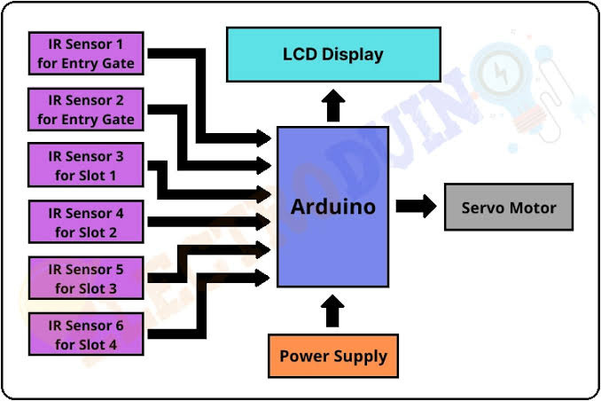
Block Daigram
08-10-2024
Department of ECE, KSSEM
3

Slide 5
Advantages , Applications, Limitations
Advantages:
Lower Pollution
Real-Time Availability Monitoring
Space Optimization and Traffic Management
Time-Saving
Limitations:
Expensive Construction & Installation
Requires Regular Maintenance
Technical Failures
Limited Accessibility
Applications:
Shopping Malls and Office Buildings
Airport/Railway Parking
Mall Parking
08-10-2024
Department of ECE, KSSEM
4

Slide 6
References
Online Resources
08-10-2024
Department of ECE, KSSEM
5

Slide 7
Thank You

